Slide 1
Exposing Azure OpenAI service
With multiple Azure Subscription, or resource groups

Slide 2









Virtual Network Peering to another VNET on forwarding subscription
u
This is a tenant specific subscription
A “forwarding” Azure Subscription, or resource group that has Azure API Management.
Virtual Network is peered with the Virtual Network in “forwarding” Azure Subscription, or resource group . Example configuration.
Restrict network traffic with Network Security Groups between subnets.
Key Vault service secures the Azure OpenAI API key(s) and exposed on a private link (not open to internet)
Azure OpenAI is accessed over a private link
Service is called from the API management on the front end Azure subscription, or resource group
The code is running under a managed identity
The code accesses the Key Vault to get the secret, using the MI as the identity
Code accesses the Azure OpenAI service using the API key received from the Key Vault
Virtual Network
v
Subnet
Subnet
|
x
Custom code exposing an endpoint for authorization
Private Link
Key Vault
z
{
Service call
}
y
Private Link
Azure OpenAI
Managed identity
w
Network Security Group
Azure subscription, or resource group for tenant

Slide 3


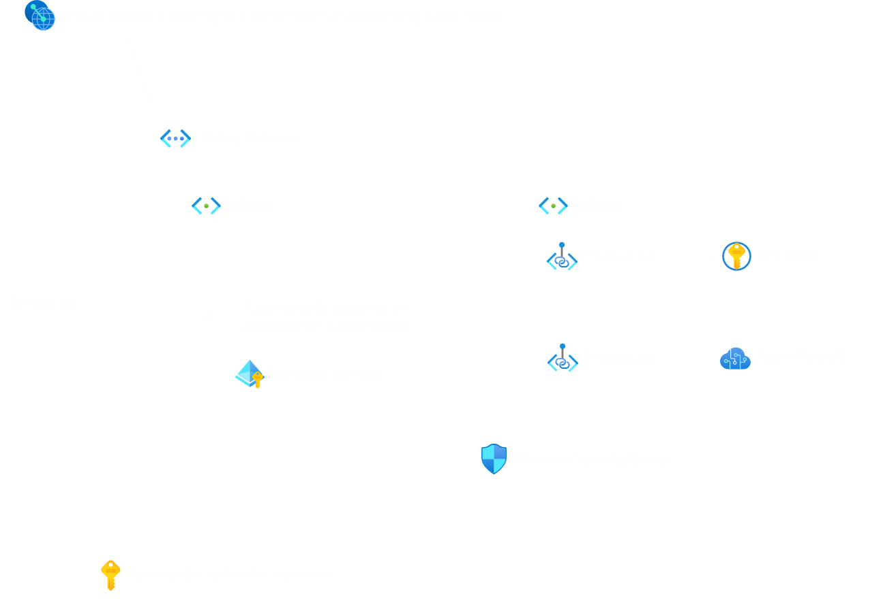

Frontend Azure subscription, or resource group
The API endpoint is exposed to the other clients
An optional next generation firewall such as Azure Firewall Premium allows network level controls
API Management enables security controls at the API level
VNETs are peered
Azure Active Directory controls access to all Azure resources for control plane, i.e. adding/deleting/updating Azure resources
Subnet
Subnet
v
w
Azure Firewall Premium
API Management service
u
x
y

Slide 4
Virtual Network
Subnet
Subnet
Subnet for code
10.0.0.0/24
Subnet for private endpoints
10.0.1.0/24
Azure subscription, or resource group for tenant

Slide 5
Virtual Network
Subnet
Subnet
Private Link
Key Vault
Private Link
Azure OpenAI
Subnet for code
10.0.0.0/24
Subnet for private endpoints
10.0.1.0/24
Azure subscription, or resource group for tenant

Slide 6
Virtual Network
Subnet
Subnet
Virtual Machine
Private Link
Key Vault
Managed identity
Private Link
Azure OpenAI
Subnet for code
10.0.0.0/24
Subnet for private endpoints
10.0.1.0/24
Azure subscription, or resource group for tenant

